Slide 1

Wrench Monkey
Group 9:
Matthew Crespo - EE
Matthew Trump - CpE
Rachael Sak - EE
William Wandelt - EE

Slide 2

Motivation
Rachael Sak (EE)
Expand the uses for toolboxes in shared workspace environments
Allow for seamless collaboration between workers
Current tool tracking methods are inadequate for an increased number of users
Create an innovative way to transport and manage tools in an industrial environment

Slide 3
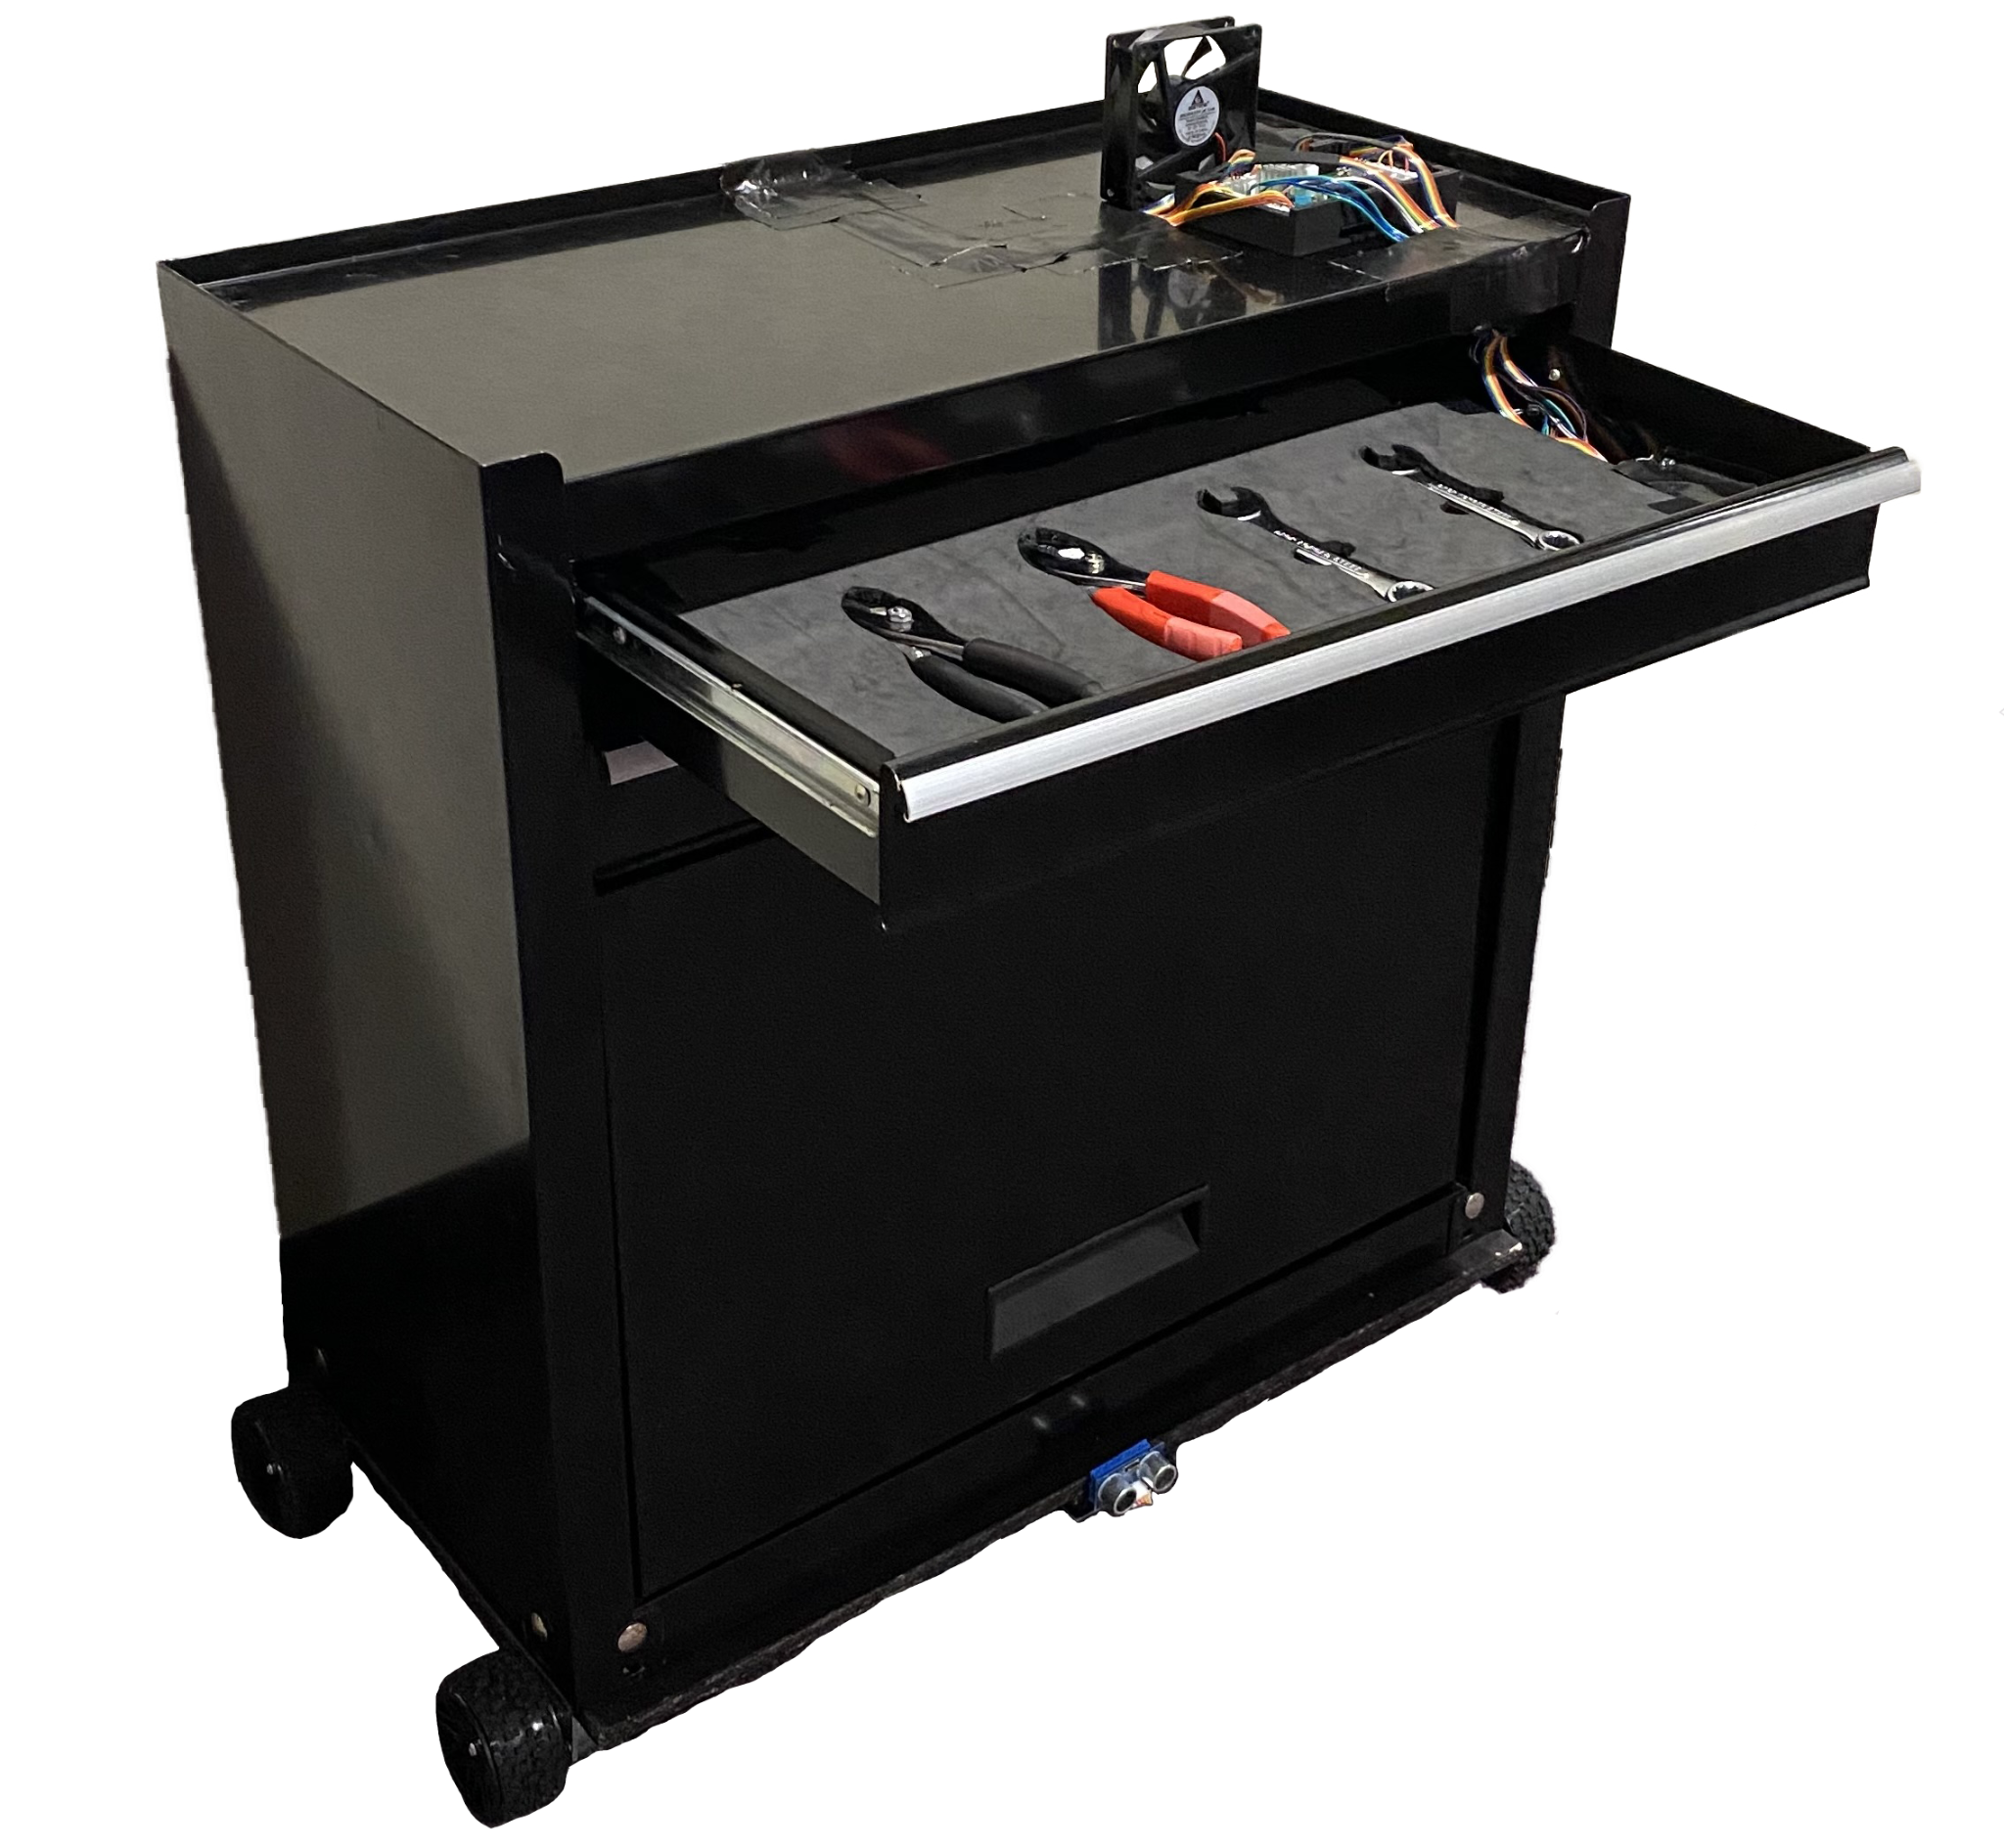
Overview
Rachael Sak (EE)
Create an semi-autonomous robotic toolbox that will navigate between workspaces
Develop a software tool tracking system
Create a user interface that allows tool requests to be sent
Implement a tool sensing system to detect which tools are removed/replaced

Slide 4
Engineering Specifications
Motorized Carrier
Carrier Weight (exc. battery) | < 7 kg.
Carrier Weight Capacity | < 15 kg.
Power Consumption | < 5W idle
Speed | < 250 mm/s
Battery Runtime | > 5 hours mixed use
Dimensions (LxWxH) | 0.6m x 0.3m x 0.2m
Maximum Working Area | 40 sq. m
Line Following Distance | > 5m
Toolbox
Weight (exc. battery) | < 20 kg.
Dimensions (LxWxH) | 0.6m x 0.3m x 0.9m
Tool Capacity | ≥ 4 tools
Rachael Sak (EE)
Overall Project
Dimensions (LxWxH) | 0.6m x 0.3m x 1.1m
Total Weight | < 40 kg.
Communication Frequency | 2400 MHz
Emergency Stop Latency | ≤ 1.5s
Voltage Input | 12V
Obstacle Detection Range | > 1m
Tool Detection Accuracy | > 90%
Cost | < $1000
Notes:
The table shown here displays the engineering specifications for the Wrench Monkey. For our demo, we plan to show the highlighted requirements, which are the maximum speed, which is determined due to workplace safety standards, the maximum latency from when the emergency stop button is used to when the robot stops, and the minimum accuracy of the tool detection system.

Slide 5

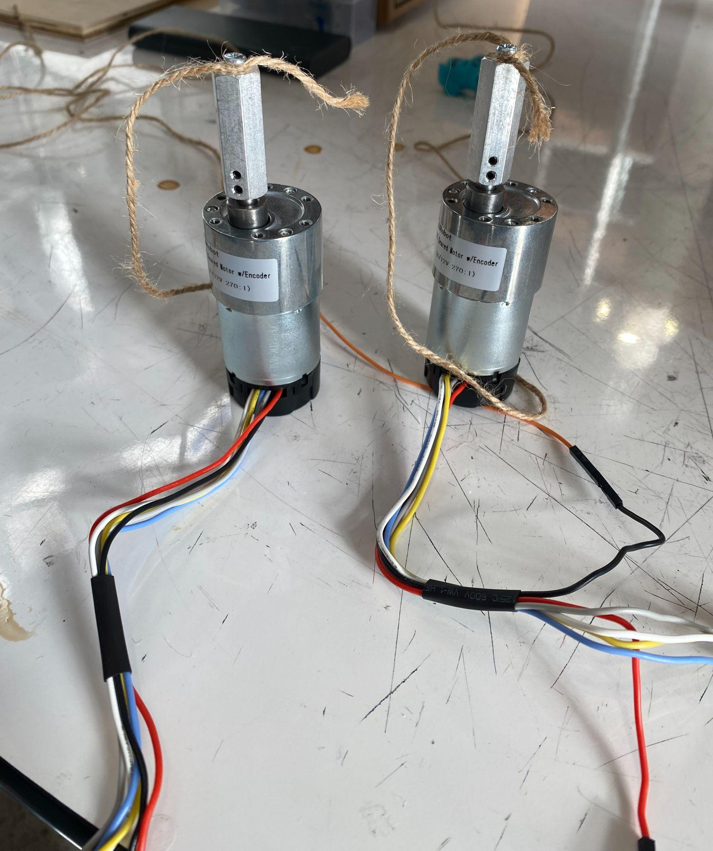
Motor Type Comparison and Selection
William Wandelt (EE)
Motor Type | RPM | Torque | Precision
Brushed DC | 3000-12000 | 0.00102 - 0.01020 kg*cm | 10+°
BLDC | 2000-6000 | 0.00102 - 0.00510 kg·cm | 10+°
Stepper | 200-600 | 4.5 - 5 kg*cm | 0.9°
Servo | 13-1600 | 3 - 70 kg*cm | 5.62°
Motor Choice | Cost | Torque | Mounting Style | Documentation
CQRobot | $33 | 70kg.cm | Parallel | Yes (Wiki)
Walfront | $16 | 25kg.cm | Perpendicular | No
Notes:
When deciding what motor type to use, heavy emphasis was put on the torque output capabilities and RPM of the motor itself. The high weight of the project, coupled with the need to move relatively quickly, meant that a balance between output torque and RPM needed to be made.
This requirement excluded brushed and brushless DC motors from our selection, as the RPM of these motors is too high, while the torque is too low. Additionally, due to the budget and complexity-conscious nature of our project, stepper motors were excluded due to the lower RPM and need for additional control circuitry to operate.
This left servo motors as our selection for use in the project. Specifically, the CQRobot CQR37D with an output RPM of 40 and output torque of 70kg*cm. The high RPM and high torque made this motor perfect for our use case. The available documentation from the manufacturer’s website also makes integration extremely simple as there is no need to guess or experiment what each wire does or how to connect it properly.

Slide 6
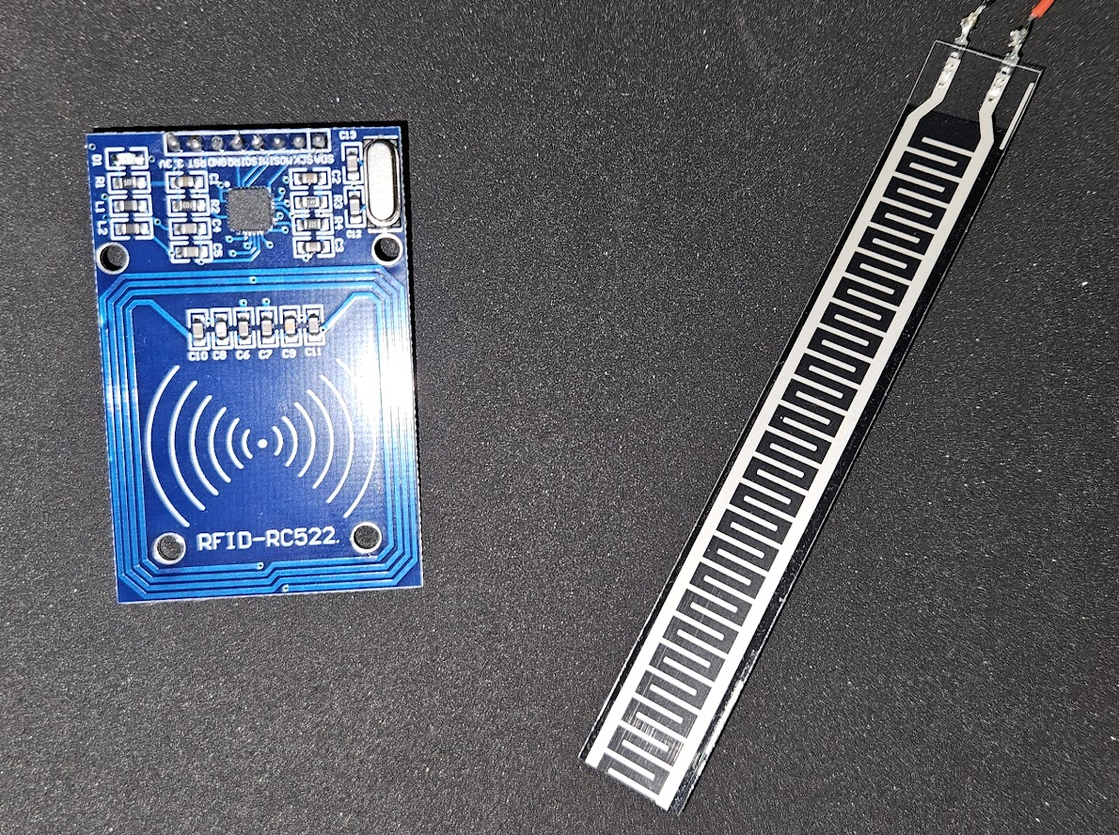
Tool Detection Sensor Comparison and Selection
William Wandelt (EE)
Sensor Type | Cost | Size | Accuracy | IO Pins Required
Strain Gauge | < $5 | 0.75 x 7 in. | 95% | 1
Capacitive | $10+ | 1 x 1 in. | 90% | 1
Photoelectric | $5-10 | 0.5 x 1 in. | 95% | 2
RFID | $5 | 1.5 x 2.3 in. | 99% | 5
Tool Detection | Cost | Pins Required | MTTF
HiLetGo RFID | $3.33 | 8 | 10+ years
Marhynchus Thin Film Strain Gauge | $6.00 | 2 | 2+ years
Notes:
Multiple tool detection methods were considered in our design. The main factors focused on were the price, size, and complexity to integrate. For our rudimentary tool detection, a simple resistive strain gauge is used, as it is small, cheap, and accurate enough for the purpose of binary tool detection. For the more complex tool detection, which can determine if a given tool is correctly placed in the right location, a HiLetGo RC522-based RFID reader is used. This will be in conjunction with programmed RFID tags attached to the tools to identify each to the system.

Slide 7
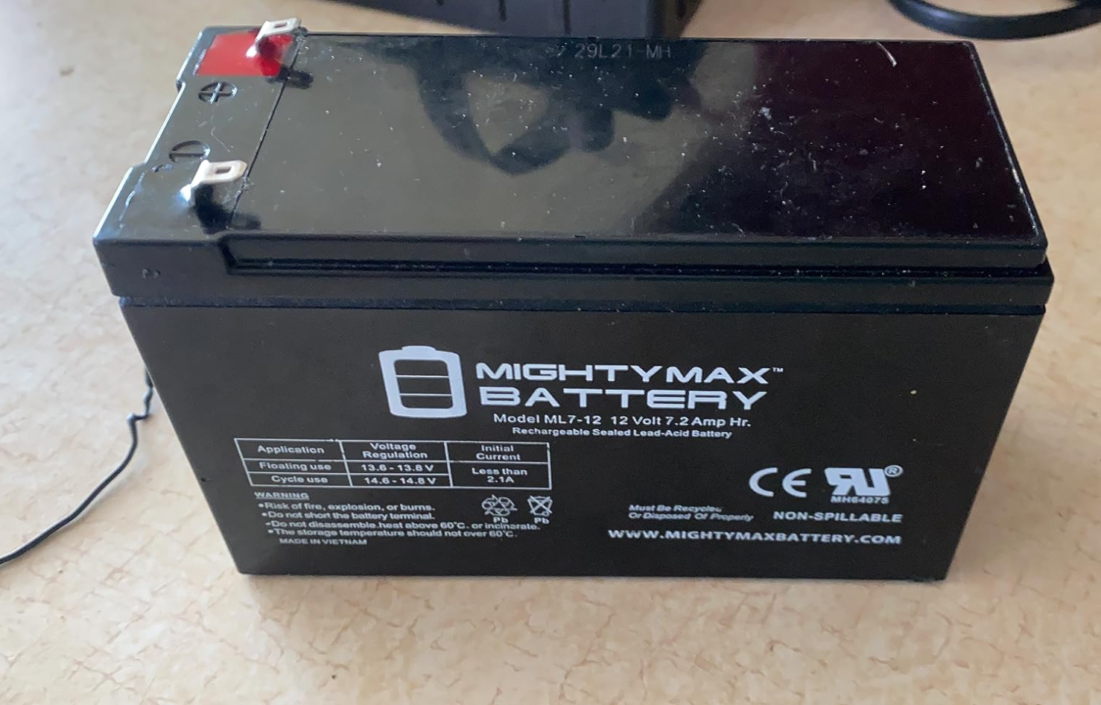
Battery Type Comparison and Selection
William Wandelt (EE)
Battery Choice | Cost | Capacity | Footprint | Weight
Casil | $21.99 | 4Ah | 3.58 x 2.76 x 3.94 in. | 4.5 lbs
Mighty Max | $19.99 | 7Ah | 5.94 x 2.56 x 4.07 in. | 2.7 lbs
Battery Type | Cost | Weight | Energy Density | BMS Required
Lithium-Ion | $30+ | < 1 kg. | 150-200 Wh/kg. | Yes
Sealed Lead-Acid | $20-25 | 1-2 kg. | 30-50 Wh/kg. | No
Nickel-Cadmium | $20-25 | 1-2 kg. | 40-60 Wh/kg. | No
Notes:
When deciding what battery type to use, the biggest factor was the price and capacity. A low weight was desirable to reduce power consumption from the motors as well as keep the overall system weight down, but this came at a higher price. Additionally, a sufficiently high capacity was also needed, as to allow the system to operate for multiple hours between recharging. This lead to us selecting lead acid batteries over the other chemistries available, as these types are known for low cost, relatively small size, and sufficient energy density for use in our project.

Slide 8
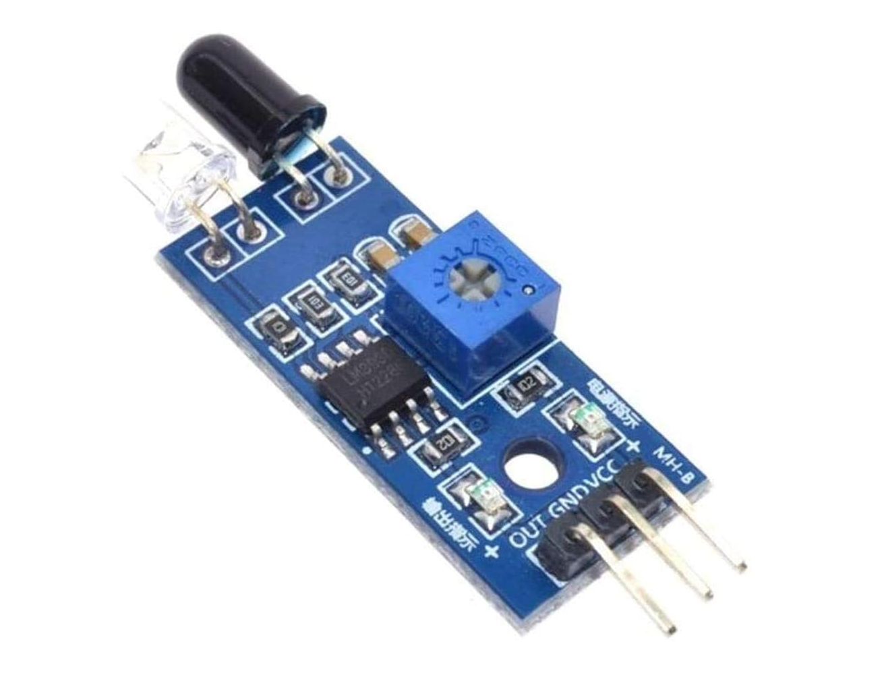
Line Detection Sensor Comparison and Selection
William Wandelt (EE)
Line Detection Sensor | Power/IO Pins Required | Cost
Color | 4-8 | $7.00
Camera | 18 | $8.99
IR (sensor array) | 7 | $11.98
Sensor Choice | Cost | Pins Required
OSOYOO | $11.98 | 7
HiLetGo | $8.79 | 15
Notes:
For our method of line detection, which is integral to the functionality of our project, we opted to use common, low cost infrared sensors. These low cost, simple sensors make integrating a line following functionality simple by using between 2 and 5 individual sensors, and employing corrective control algorithms to ensure the system stays on track. Cameras and color sensors were considered, however these solutions either used too many IO pins, or required too much processor overhead for line recognition, such as in the case with the camera. With this, we ended up using a 5 sensor IR array from OSOYOO

Slide 9
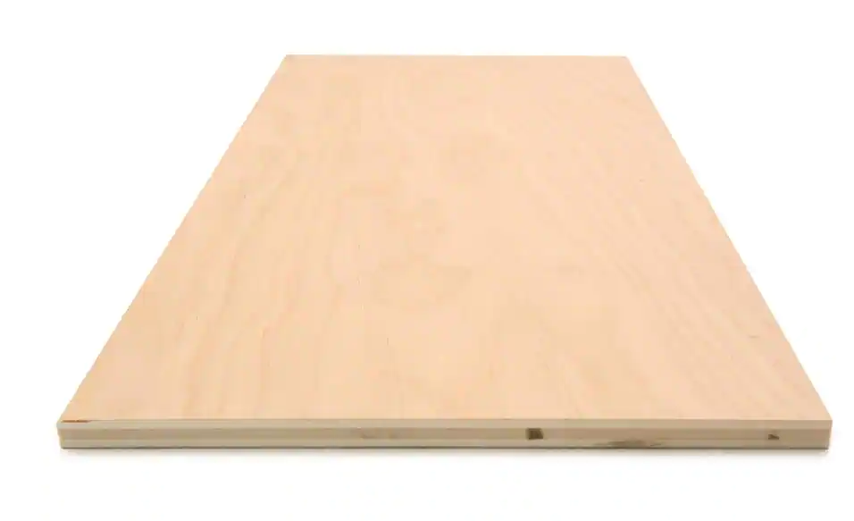
Chassis Base Material Comparison and Selection
William Wandelt (EE)
Chassis Base Material | Cost | Shear Strength | Ease of Manipulability
Wood | < $10 | 1.9 MPa | High (Hand Tools)
Aluminum | $200+ | 207 MPa | Low (Machining)
Plastic | $50+ | 100-150 MPa | Medium (Hand Tools)
Carbon Fiber | $1200+ | 590 MPa | Low (Machining)
Chassis Material | Cost | Compression Strength | Density
Plywood | $9 | 3,000-5,000 PSI | 39.6 lb/cu.ft.
OSB | $5 | 1,000-1,500 PSI | 37.5 lb/cu.ft
Notes:
The choice of chassis base material was fairly straightforward. Even though carbon fiber and aluminum are very strong materials, their high price and difficulty to machine made them unsuitable for our project. Ultimately, wood was chosen due to its high availability, low cost, and ease of machining compared to plastic. More specifically, plywood was chosen due to its higher strength and density over oriented strand board, despite being slightly more expensive.

Slide 10
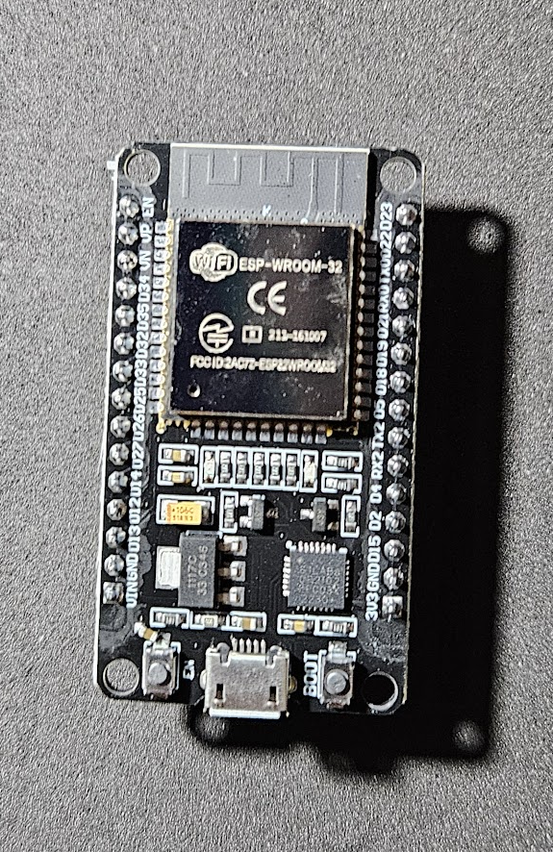
Microcontroller Comparison and Selection
William Wandelt (EE)
Microcontroller/ Single-Board Comp. | ESP-32S | Raspberry Pi 4 Model B | Arduino Uno R4 WiFi
GPIO Pins | 32 | 40 | 20
Serial Communication | I2C, I2S, SPI, UART | UART, SPI, I2C | UART, I2C, SPI, CAN
Connectivity | Wi-Fi, Bluetooth Classic, BLE | Wi-Fi Dual Band, Bluetooth Classic, BLE, Ethernet | Wi-Fi, Bluetooth Classic, BLE
Cost | 6.00 USD | 75.00 USD | 27.50 USD
Notes:
Multiple microcontrollers were considered when initially designing our system. The main comparison points we had to decide on were the overall processor capabilities such as processing speed, as well as included features and peripheral support, such as WiFi and SPI. However, the main 2 factors influencing our decision were the number of IO pins available, and the cost. The ESP32 was the obvious choice here, as it has sufficient IO pins for our use case, with native support for WiFi and an extremely low price compared to the alternatives.

Slide 11

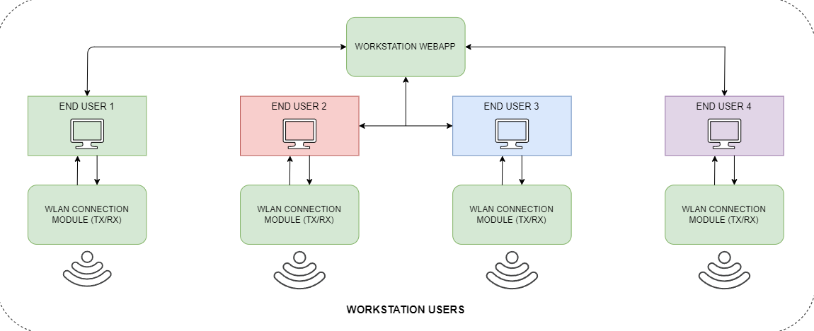
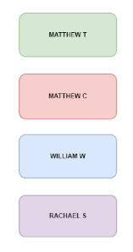
Hardware Block Diagram (Users)
Matthew Crespo (EE)
Notes:
This is a very top level overview of our hardware block diagram we can see we will have the workstation webapp, which is accessed by the users through their desktop or laptop. Then through this, they will be able to communicate to the hardware. Looking more closely, we can see that the MCU controls the main systems which consist of: navigation system, locomotion system, tool trays, and tool light controllers. On the top left we can see that the navigation system consists of an IR sensor array and ultrasonic distance sensor which send information to the MCU to then perform the motor control. In addition to that, we have the MCU receiving information from the strain gauges and RFID readers in the tool trays. This information is then used to control the lights to indicate if a tool has been properly checked out. For example, if a tool is put in the incorrect spot, a blue light will flash alerting the user of the misplacement.

Slide 12
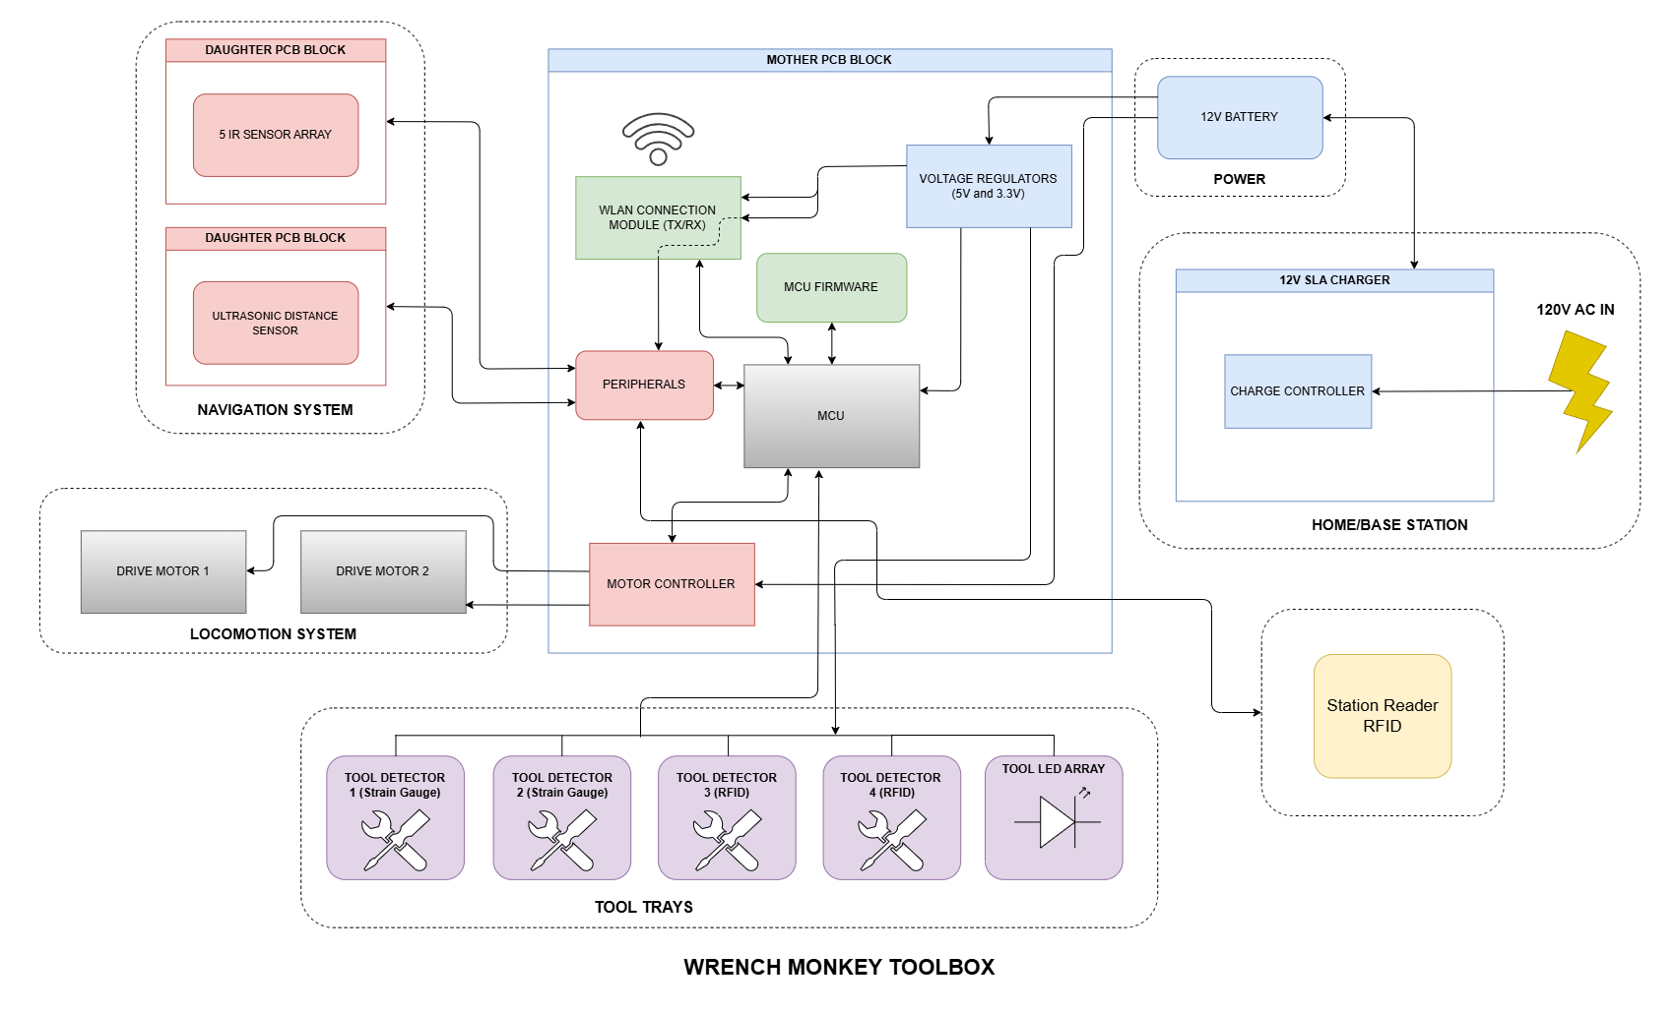
Hardware Block Diagram (System)
Matthew Crespo (EE)
Notes:
Looking more closely, we can see that the MCU controls the main systems which consist of: navigation system, locomotion system, tool trays, and tool light controllers. On the top left we can see that the navigation system consists of an IR sensor array and ultrasonic distance sensor which send information to the MCU to then perform the motor control. In addition to that, we have the MCU receiving information from the strain gauges and RFID readers in the tool trays. This information is then used to control the lights to indicate if a tool has been properly checked out. For example, if a tool is put in the incorrect spot, a blue light will flash alerting the user of the misplacement. Finally, the whole system is powered by a 12V battery that is able to be recharged by being plugged into a wall.

Slide 13
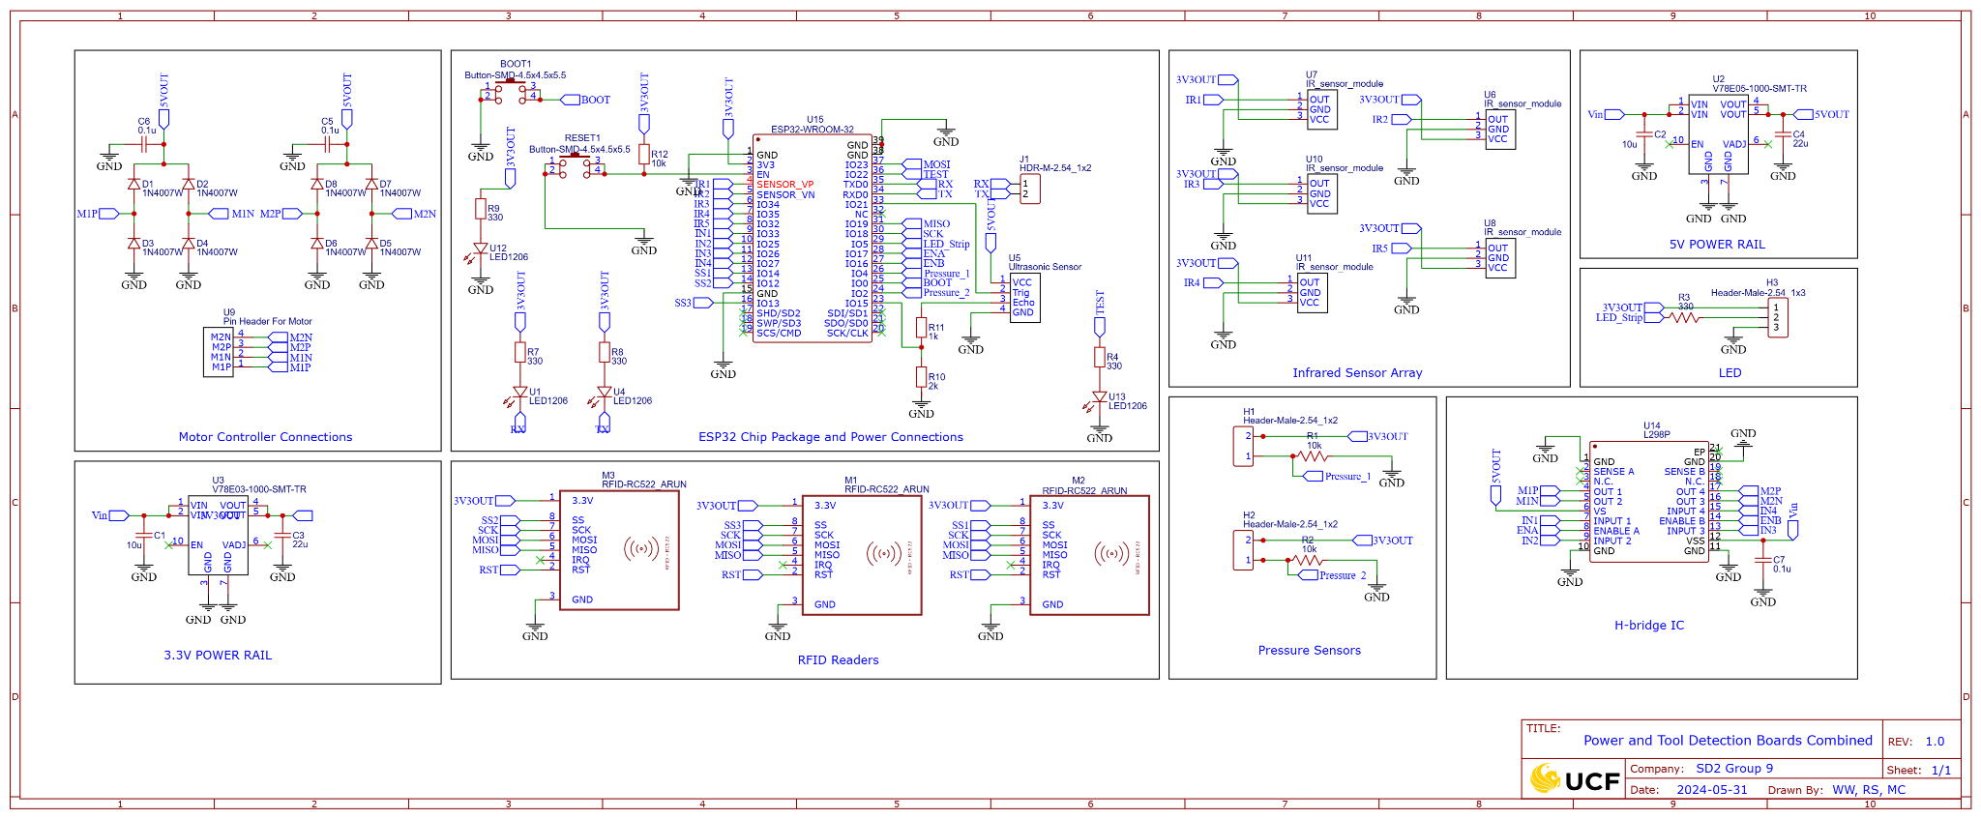
Main Control Board Schematic
Matthew Crespo (EE)

Slide 14
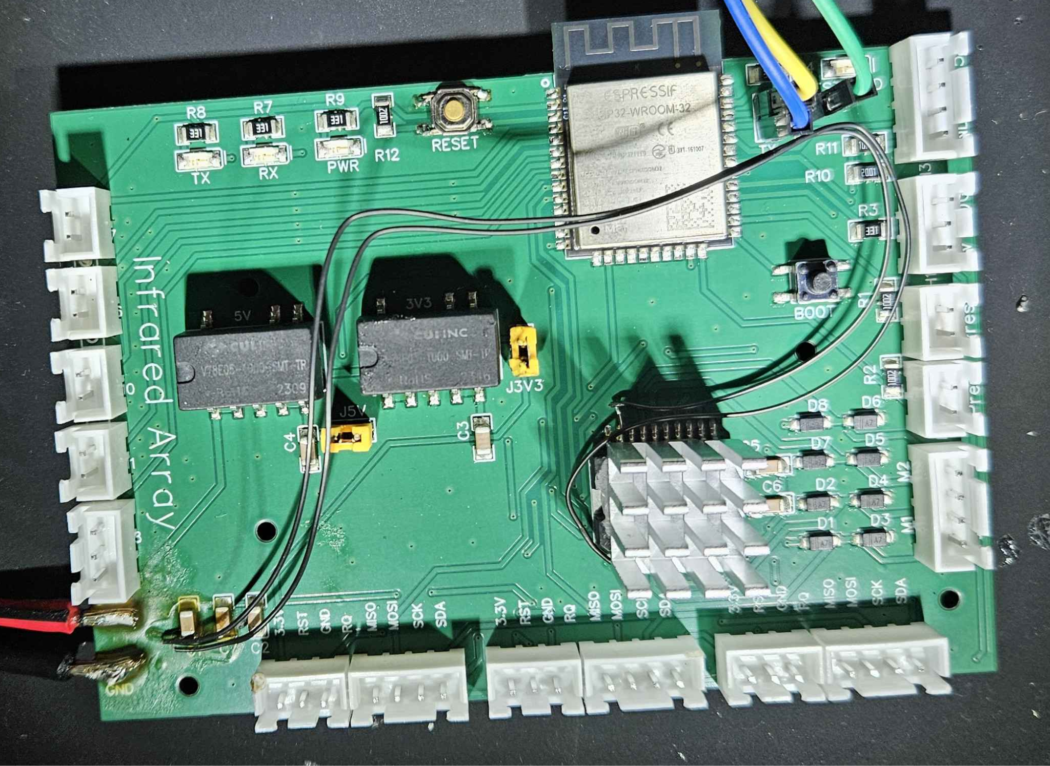
Main Control Board PCB
William Wandelt (EE)
Main PCB has multiple sections
Notes:
The main control board PCB shown here has multiple different sections, each responsible for a different portion of Wrench Monkey’s goals

Slide 15
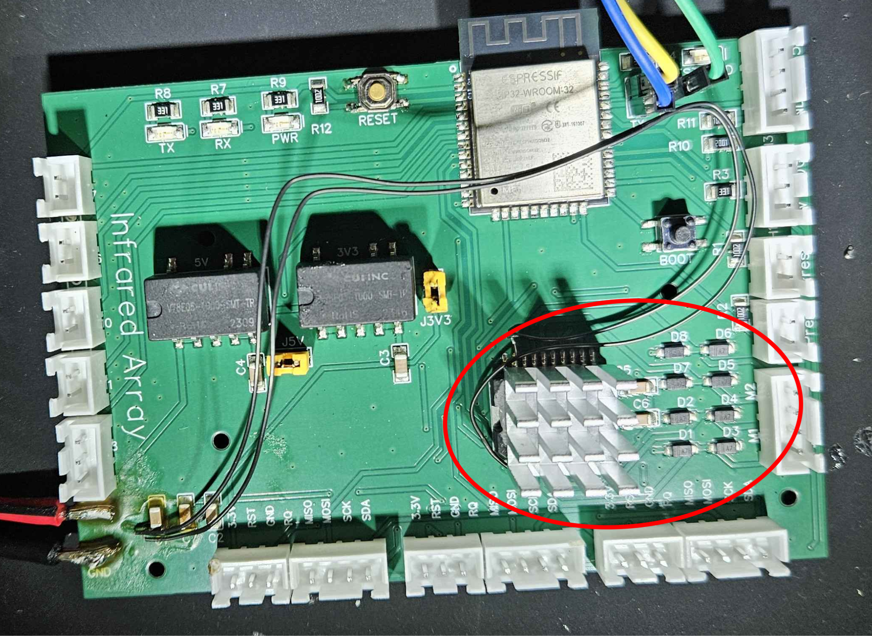
Main Control Board PCB
William Wandelt (EE)
Main PCB has multiple sections
Motor Control
Notes:
Firstly shown here is the motor control section for the mobile chassis portion, which is comprised of an L298p Dual h-bridge to control 2 motors independently. Additionally, an array of flyback diodes and filtering capacitors is used to control the path of back EMF from each of the brushed DC motors. Thermal vias on the underside of the chip along with a heatsink are used to ensure the temperature of the chip is maintained at a safe level. Consideration was made with PCB trace thickness for the H bridge supply and Motor power traces to ensure the board was not damaged during operation. This section was based on an example schematic given in the chip’s datasheet

Slide 16
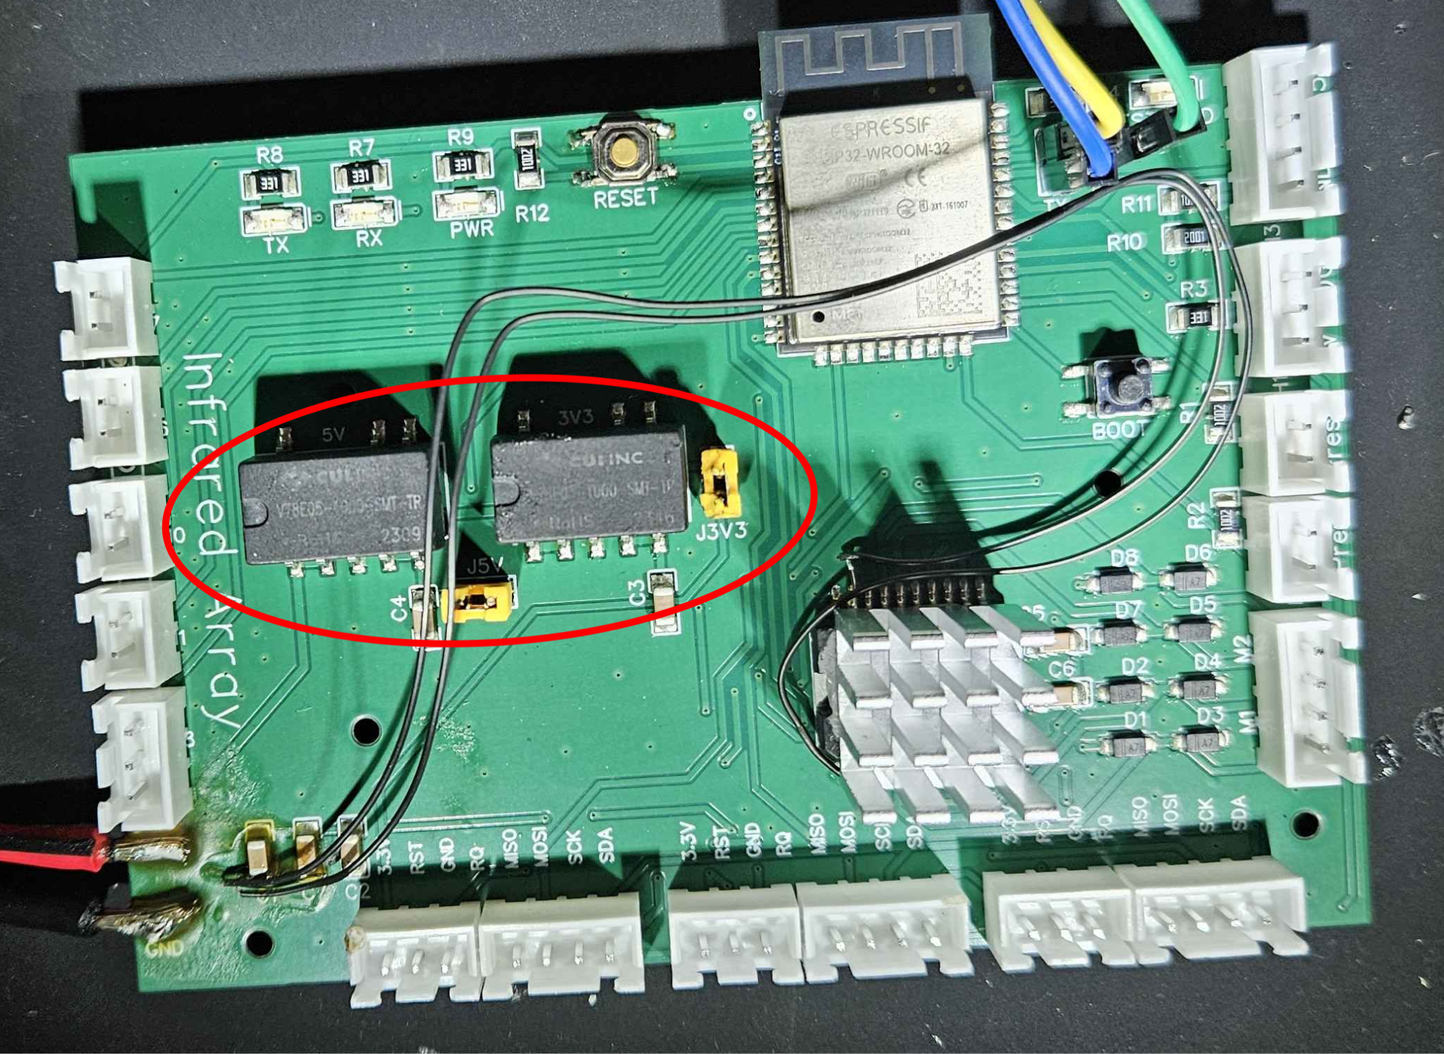
Main Control Board PCB
William Wandelt (EE)
Main PCB has multiple sections
Motor Control
Power Regulation/Distribution
Notes:
The section shown here is comprised of 2 fully integrated switching regulators, for both 3.3 volt and 5 volt regulation. Filtering capacitors are applied on the input and output to clean the regulation. Each are capable of supplying up to 1 amp of current, which was more than enough for Wrench Monkey. Because switching regulators generally do not require thermal management, linear regulators were not considered due to their high inefficiency, especially for large input output voltage deltas.

Slide 17

Main Control Board PCB
William Wandelt (EE)
Main PCB has multiple sections
Motor Control
Power Regulation/Distribution
Microcontroller Unit
Notes:
The section shown here is the MCU used, the ESP-WROOM-32. It was chosen due to its low cost, native wireless capabilities, and large amounts of IO. All 24 available IO pins on this module were used in Wrench Monkey for each of the peripherals utilized.

Slide 18
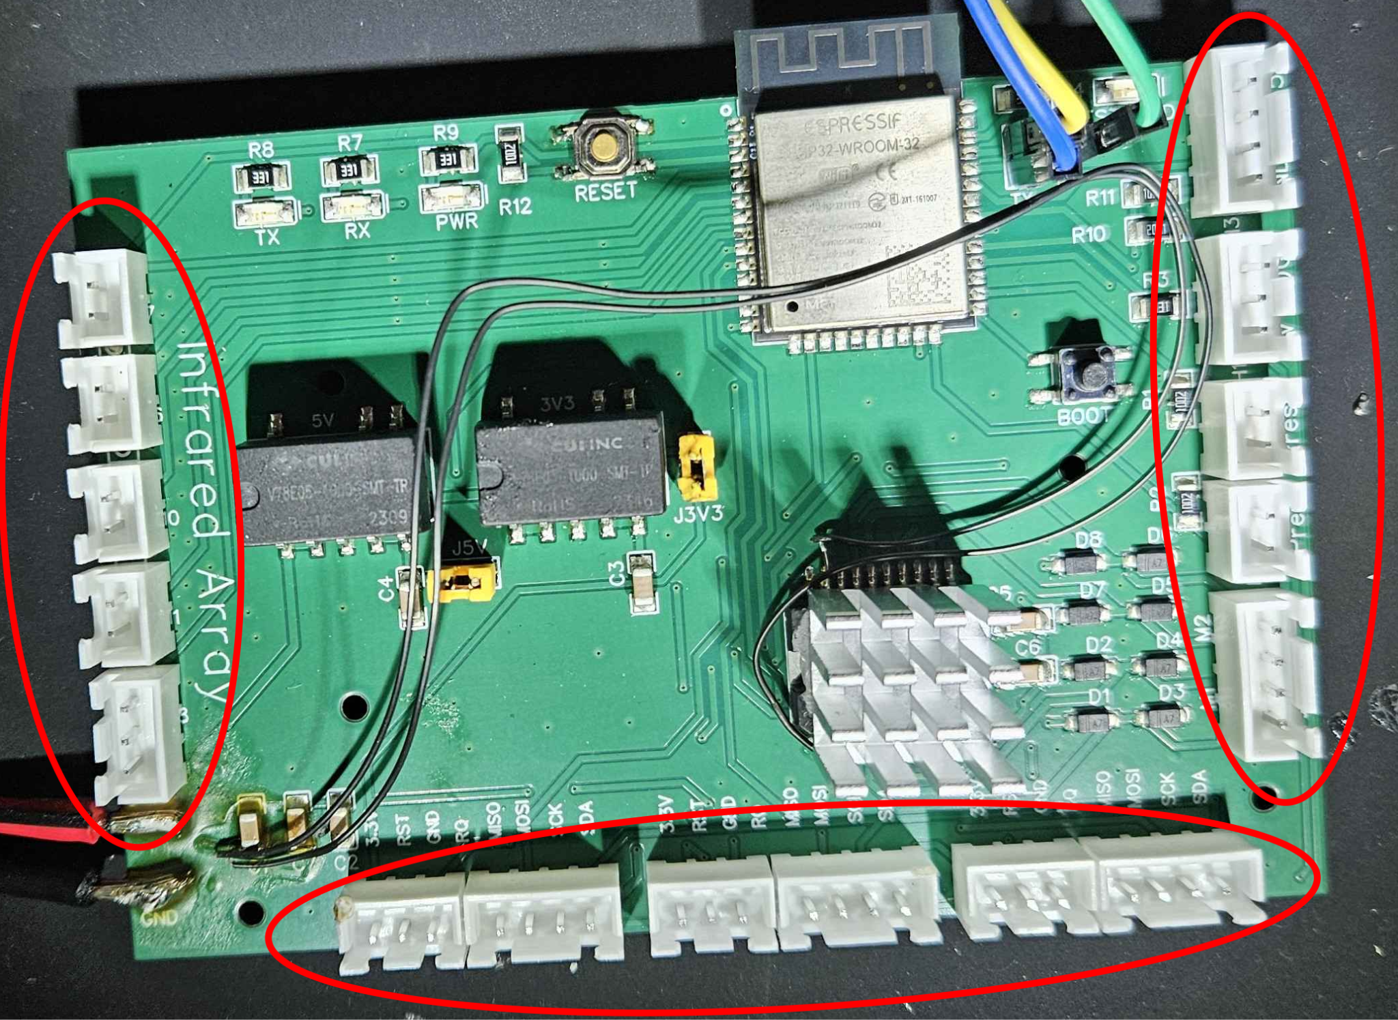
Main Control Board PCB
William Wandelt (EE)
Main PCB has multiple sections
Motor Control
Power Regulation/Distribution
Microcontroller Unit
Peripheral Connections
Notes:
Lastly, shown here are the connectors for all of the peripherals used in Wrench Monkey. The left most column is where the 5 IR sensor array connects to the ESP. The bottom row is where all of the 3 RFID sensors used connect. The rightmost column is where the ultrasonic sensor, pressure sensor, tool drawer LEDS, and chassis motors connect.

Slide 19
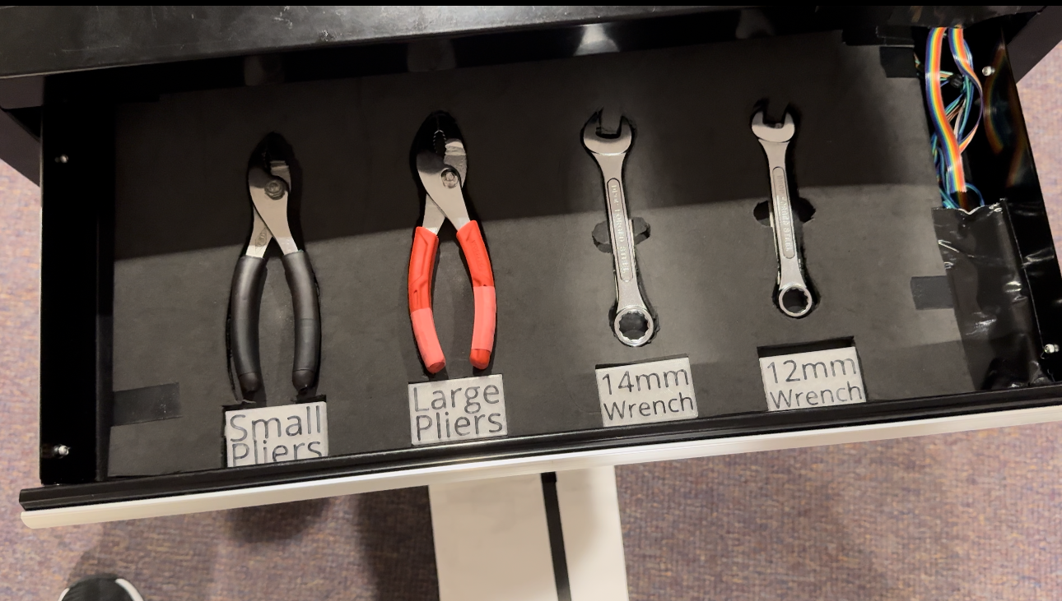
Tool Drawer
Rachael Sak (EE)
Notes:
Talk about foam, rfid, pressure sensor, led etc

Slide 20
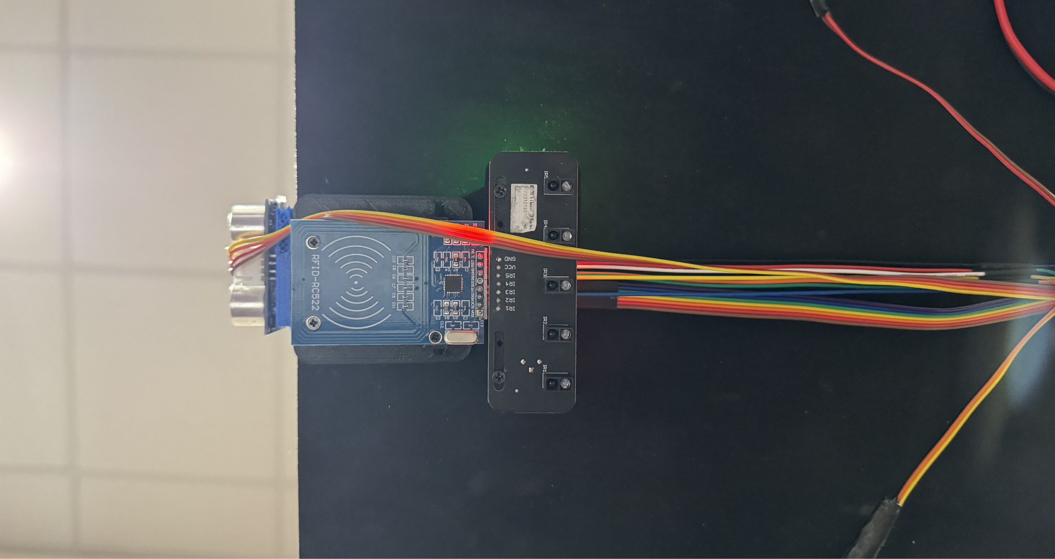
Navigation Sensor System
Matthew Crespo (EE)
Notes:
For the navigation sensor system we used an ultrasonic sensor, RFID reader, and IR sensor array with 5 IR sensors. The ultrasonic distance sensor is used for obstacle detection. The RFID reader is used for station detection. And finally, the IR sensor array is used for implementing the PID control line following.

Slide 21
Control Technique Comparison and Selection
Matthew Crespo (EE)
Control Technique | Mathematical Modeling Required | Tuning Method
Bang-Bang | No | -Trial and error
PID | No | -Trial and error -Ziegler Nichols
MPC | Yes | -Changing objective function
RL | No | -Change rewards -Change reward structure

Slide 22
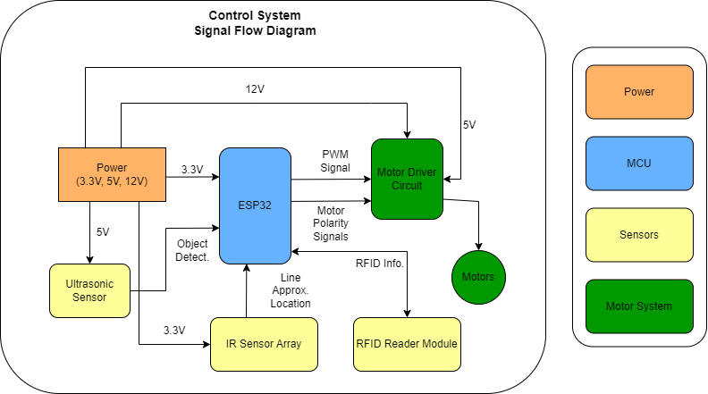
Control System Signal Block Diagram
Matthew Crespo (EE)

Slide 23

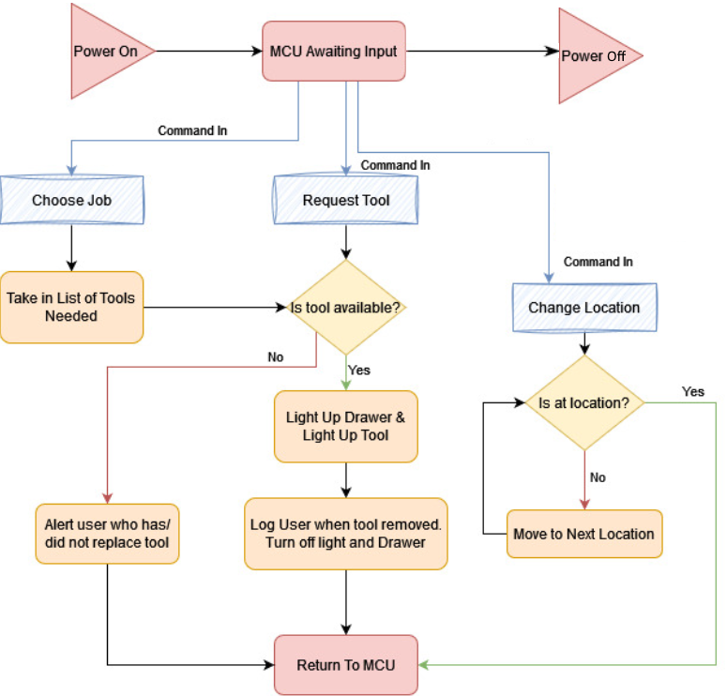
Software Block Diagram
Matthew Trump (CPE)
Notes:
Let me walk you through our software block diagram. There are three main commands the robot can receive: Choose Job, Request Tool, and Change Location. For “Choose Job”, the robot checks the list of required tools and verifies their availability. If a tool is missing, it alerts the user; if available, it lights up the drawer and tool. Once the user removes the tool it logs the data, turns off the led’s, and updates the front end and database. This process is the same yet reversed for the check in tool function. The “Request Tool” command follows the same process for a singular tool. The “Change Location” command moves the robot along a black line using IR sensors. Once over a station, it checks the station number with an RFID card and determines if it made it to the correct destination.

Slide 24








Stack Comparison and Selection
Linux
Apache
MongoDB
Express
Matthew Trump (CPE)
My SQL
PHP
React
Node
Pros and Cons of LAMP stack
Established with abundant documentation and community support.
Scaleable for medium-sized apps
Handles heavy traffic well
Limited UI libraries
PHP is older thus compatibility issues for newer frameworks
Less suitable for dynamic content
Pros and Cons of MERN stack
Modern Growing Community
Scalable for large applications
High Performance
Rich UI libraries (React)
React for dynamic content
User friendly
JavaScript, which simplifies development
Rapidly evolving, compatibility issues
Potentially more complex setup
Notes:
For the back and front end of this project, we compared the two most popular full stack development options. While the LAMP stack offers established documentation and community support, we opted for MERN due to its modern and rapidly growing community. MERN's scalability for large applications and high performance, coupled with rich UI libraries like React, made it a clear choice for us. The user-friendly nature of JavaScript simplified our development process especially since we were more familiar with its capabilities. Ultimately, MERN's dynamic capabilities and evolving ecosystem aligned better with our project's needs, driving our decision towards this stack.

Slide 25
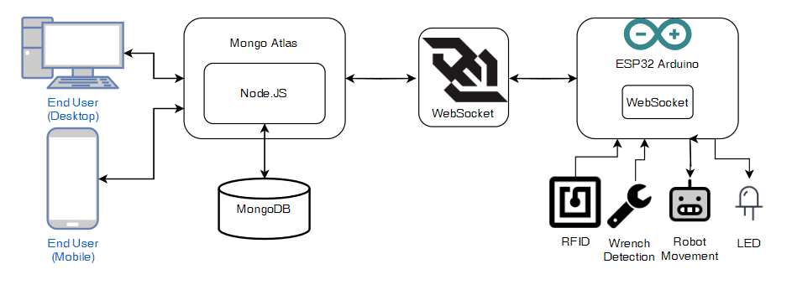
Communication and Data Transfer
User Interactions
Request Processing
Message Handler
Command Execution
Matthew Trump (CPE)
Feature | WebSocket | MQTT Broker
Communication Model | Direct, real-time, bi-directional communication | Indirect, messages go through a broker
Latency | Lower latency due to direct communication | Higher latency through broker mediation
Implementation | Easy to implement, Prebuilt arduino libraries | Additional setup and config needed
Overhead | minimal , only a single connection | Higher overhead, multiple connections
Real-time Suitability | Excellent for real time applications | Good, but some delay due to broker mediation
Data Storage
Individual Components
Notes:
These are the steps involved in communicating with Wrench Monkey. First we have our end users who interact with our system through either a desktop website interface or the mobile application. These interfaces send and retrieve data from MongoDB Atlas, our cloud-based database service, which stores information such as tool detection, user actions, and status updates. Node JS, running on our server, processes these requests from the end users. Next, Atlas and Node.js communicate with the WebSocket server. WebSocket is chosen for Wrench Monkey because it provides real-time, low-latency, bi-directional communication, which is crucial for applications requiring instant updates. Its simpler implementation and lower overhead than the MQTT Broker making it easier to manage and maintain. Finally the ESP32 sends and receives commands from the WebSocket executing the appropriate action.

Slide 26




Development Technologies
Matthew Trump (CPE)
Expo is an application for testing React apps
Mobile App for IOS and Android to stream React App
Real-time updates for modifications
No need for emulators
Use of multiple devices at the same time
REST API Interface is for communication between different systems
Uses HTTP requests to GET, POST, PUT, or DELETE data
Allows the ESP32 to interact with server and database
Uses a queue based system to send commands
No need for port forwarding
Arduino IDE is the Integrated Development Environment for programming the ESP32
Supports C or C++ languages
Provides tools for compiling and uploading code to the ESP32
Has serial monitor for debugging purposes
Extensive public libraries with examples for each case
Figma is the design tool used for prototyping user interfaces for web and mobile applications
Real-time collaboration on designs
Wide range of design components and plugins
Preset dimensions of desktop and mobile screens
Simulation of user interactions
Notes:
The following are the key development technologies we used for our project. Firstly, Expo is an application that allows for efficient testing of React applications. It supports both iOS and Android platforms, enabling us to stream the React app easily. One of its standout features is the ability to update in real time as we make modifications to the code. Next, REST API serves as the communication bridge between Wrench Monkey and our server, using HTTP requests to perform operations such as retrieving, updating, and deleting data. By employing a queue-based system, we can reliably manage and send commands without the need for port forwarding. Arduino’s IDE is the program we selected for coding the ESP32 microcontroller directly. This program supports C and C++ languages, along with numerous libraries essential for communication, allowing for easier writing and debugging of code. Lastly, Figma is the collaborative design tool we used to prototype the user interfaces for desktop and mobile use. It provided a wide range of design components and dimensions, ensuring our designs would fit the users' needs.

Slide 27
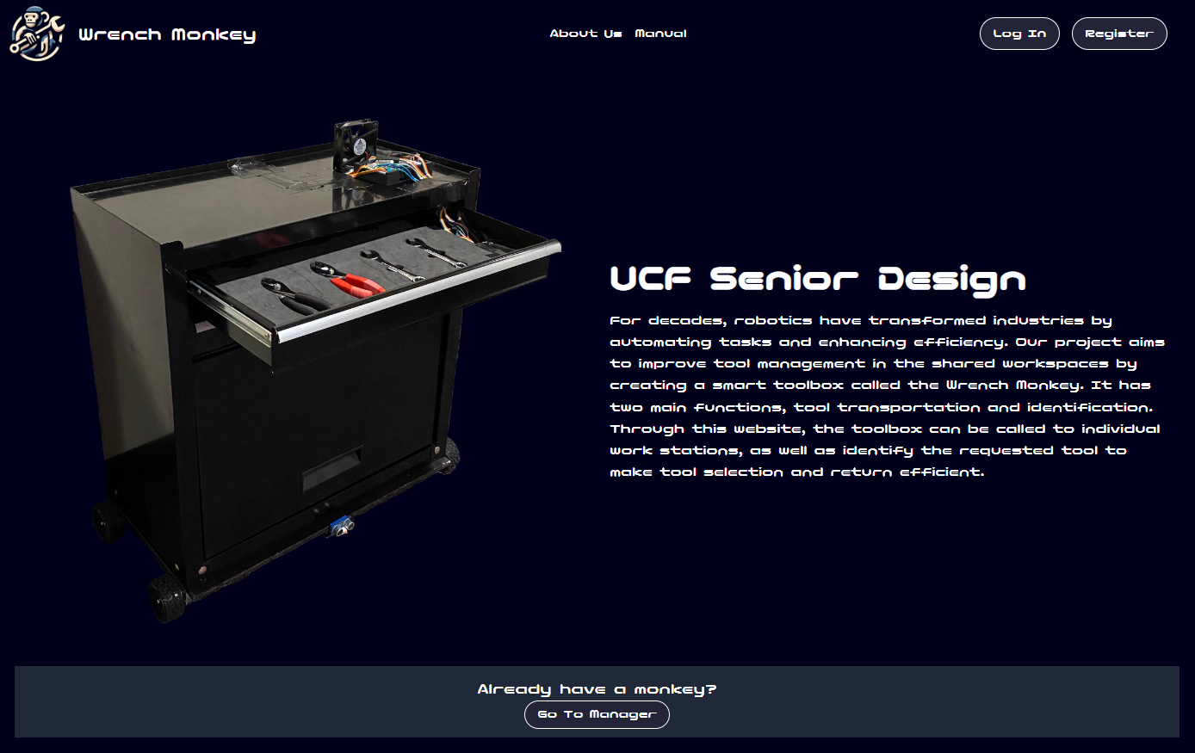
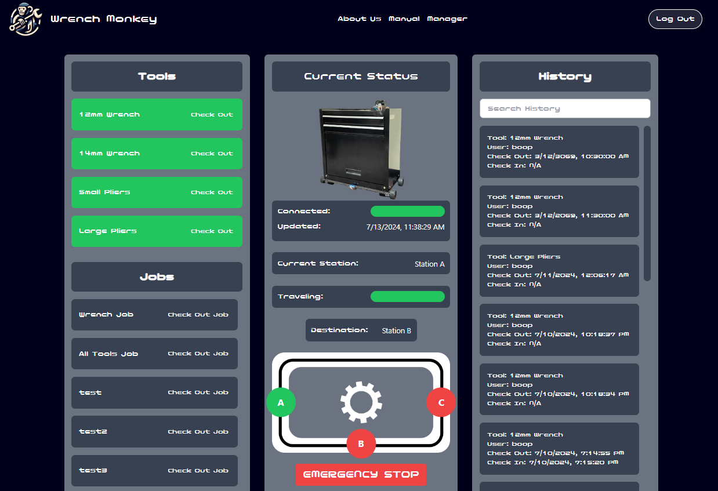
Desktop Website Interface
UI elements inspired by the mobile app for a consistent user experience
Addition informational pages such as About Us and a Usage Manual
Accessibility options include alternative text and color changes for button selection
Manager page offers a comprehensive interface with all information accessible on a single page
Matthew Trump (CPE)
Notes:
Let's look at the desktop website interface for Wrench Monkey. We've added informational pages like About Us and a Manual for user guidance. To improve accessibility, we include alternative text and color changes for buttons. After going through the registration and login process you are brought to the Manager Dashboard. The website uses server side event streams to update all information displayed to the user in live time whenever the database is modified. While looking at the right image we can see the page split into three sections. The left section shows the current status of tools allowing for check-in or check-out, only updated when tools are pulled or added to the drawer. Below that is the Jobs section for checking out multiple tools at one time. The right section displays the history of tool usage, showing check-out/check-in times and responsible users. There is also a search bar making it easy to find the entry you are looking for. The middle section shows the toolbox status, including online status, current station, travel status, and features an emergency stop button for safety.

Slide 28
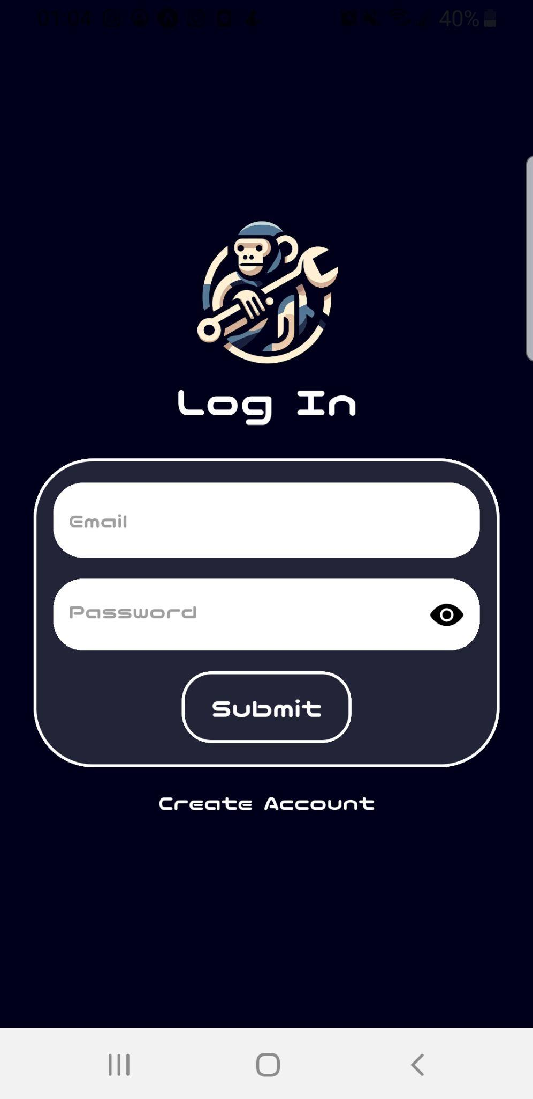
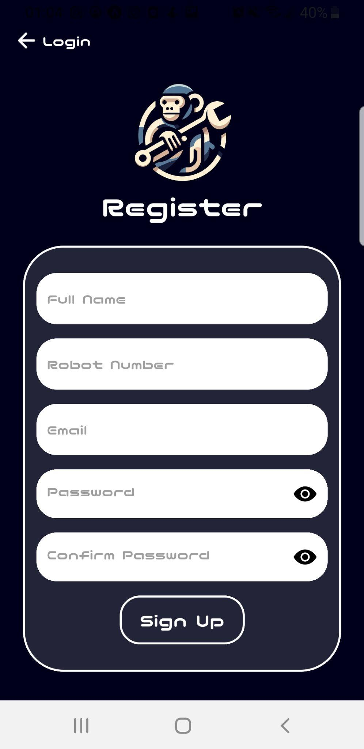
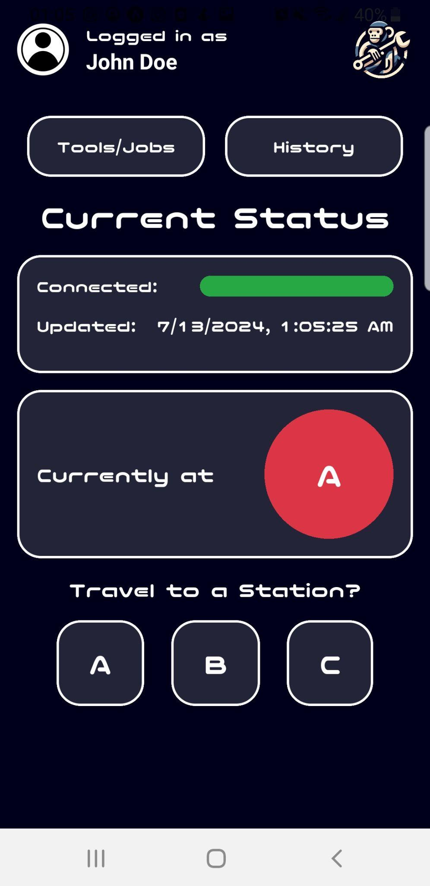
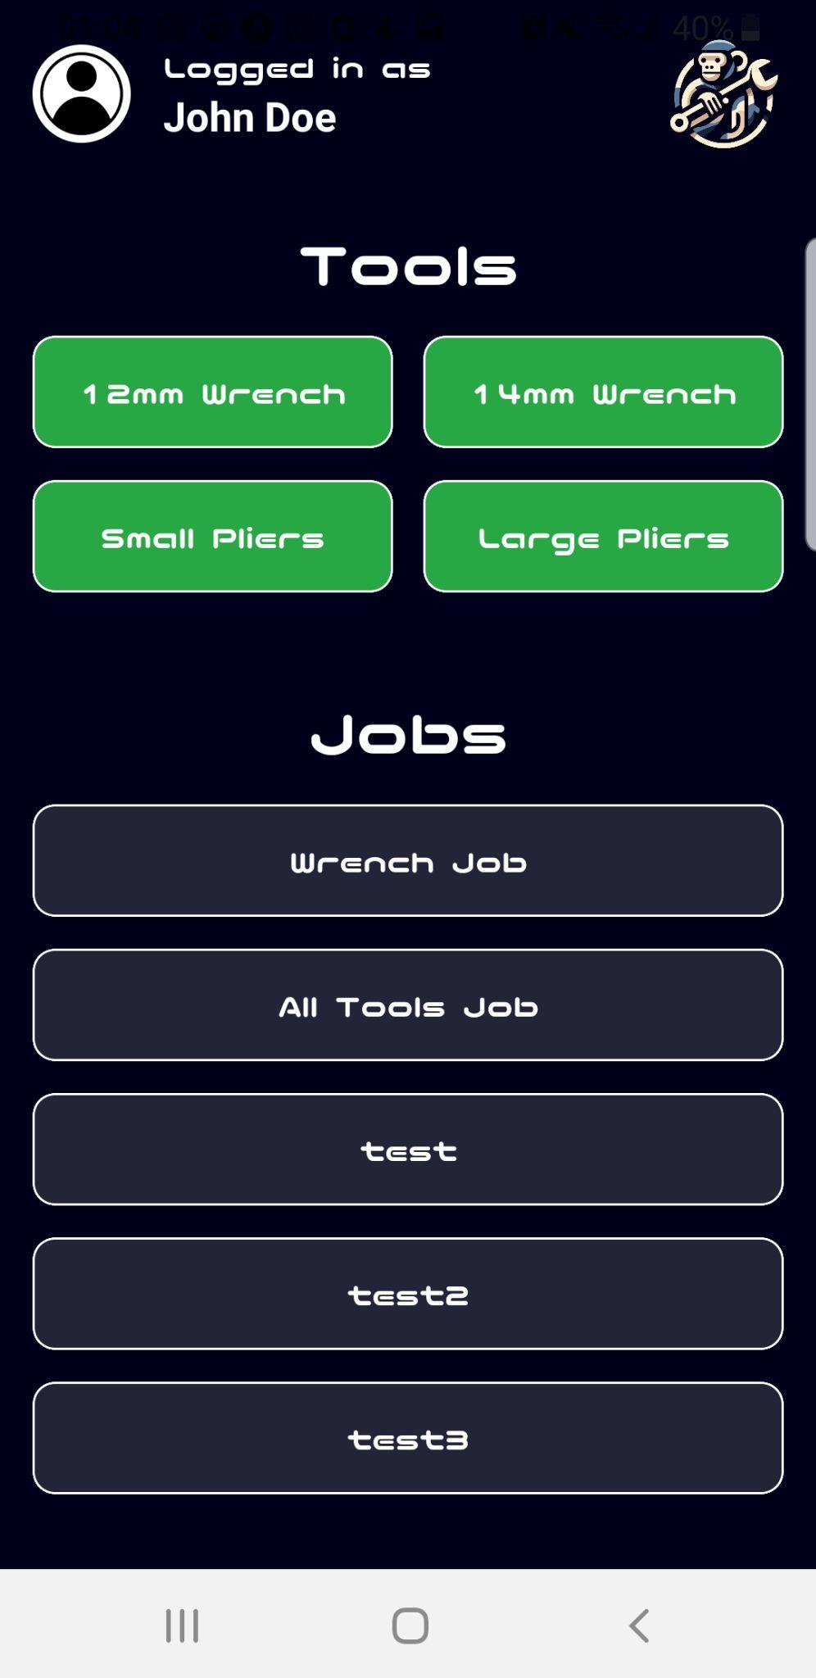
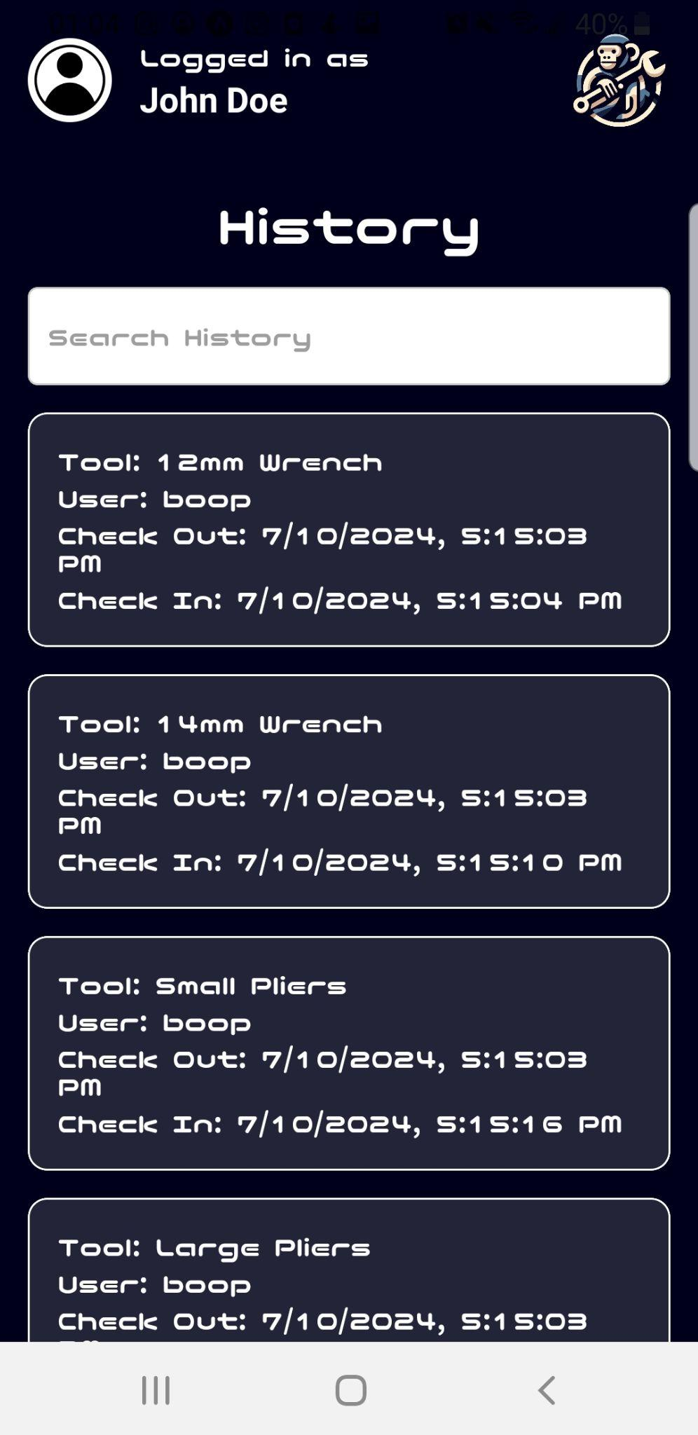
Mobile App Interface
Matthew Trump (CPE)
Login
Auto Data Storage
Registration
User Account Creation
Dashboard
Robot Status and Station Traversal
Tools and Jobs
Status of Tools
History
Tool Check-in or Check-out Records
Notes:
The mobile app interface for Wrench Monkey is very similar to the desktop version, so I'll just be highlighting the key differences. One major difference is that the login information is stored locally on the phone, allowing users to exit and reopen the app without having to log in again. Given the smaller screen size, we've designed separate pages for each section, making the information more concise. Unlike the desktop version, the mobile app does not include a Manual or About Us page. For easy navigation, users can click the logo in the top right corner to return to the dashboard screen. Additionally, the full name of the user is displayed in the top left corner for quick identification. Instead of using server-side event streams, the mobile app employs polling every five seconds to update information due to plugin issues in the React Native framework. This ensures that users still receive timely updates despite the technical limitations. Furthermore, the app is designed specifically for individual users to interact with Wrench Monkey, rather than for administrators who need to edit tool details or job details. Administrative functions remain accessible through the desktop website.

Slide 29
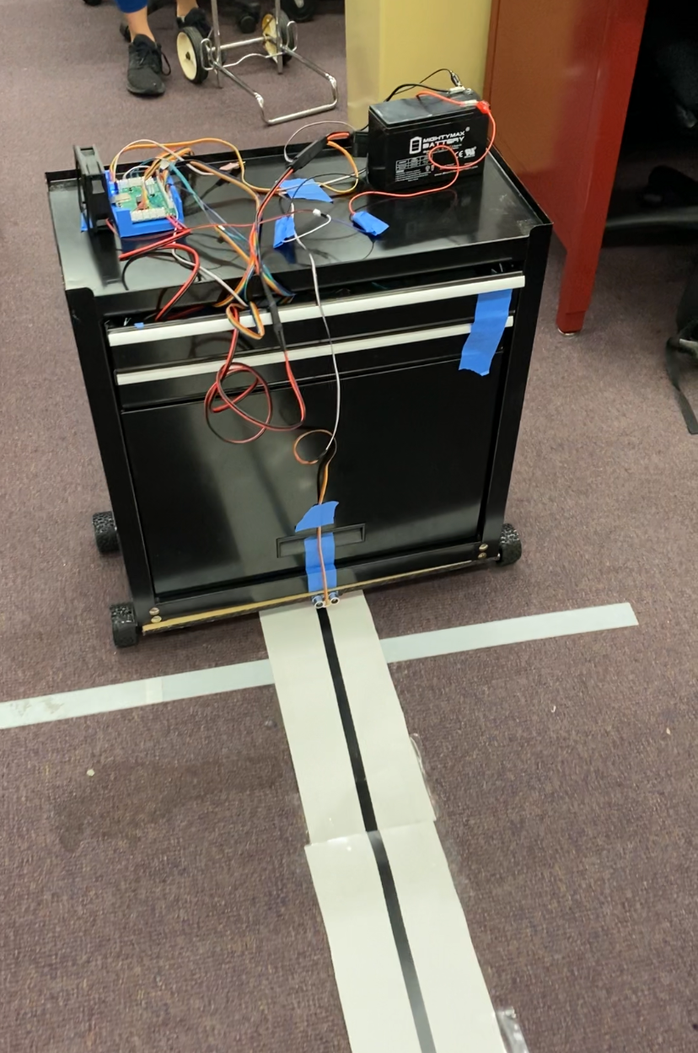
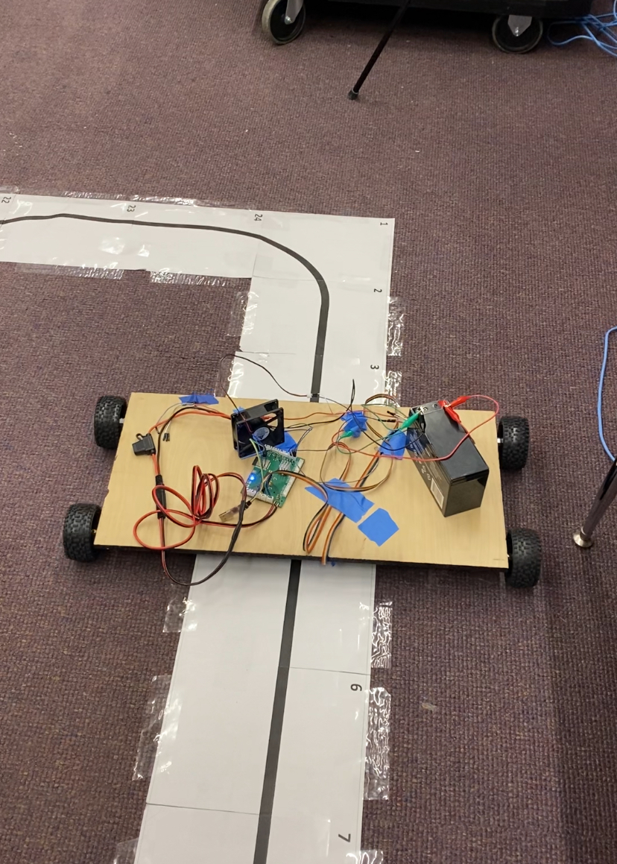
System Testing: Line Following
Matthew Crespo (EE)
H-bridge circuit testing
IR sensor calibration
Bang-bang control approach
PID control tuning
Notes:
For line following system testing, we first did initial tests on the H-bridge implementing PWM signals and by changing the output polarities. Later on, once the chassis was assembled, the IR sensors were calibrated so that they would accurately detect the ground. For the actual line following, bang-bang control was initially tested due its simple implementation which confirmed the functionality of the driving system along with its sensing capabilities. Next, to reduce the rigidity of the turns and heat generation by the h-bridge, we implemented PID control. The image on the right shows the initial PID control test with a left turn and the image on the right shows some line following with the full load.

Slide 30
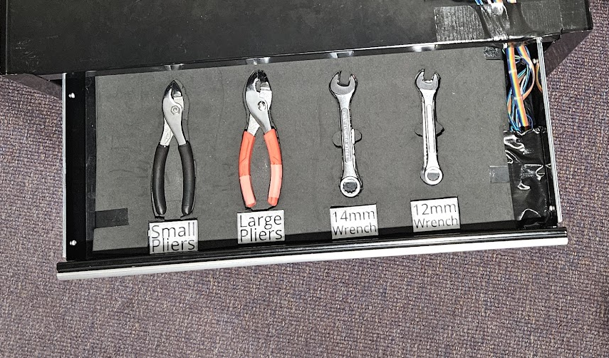
System Testing: Tool Detection
Rachael Sak (EE)
All components are individually tested
RFID sticker UIDs are read to allow for comparison
Stickers are placed, tools are placed, and sensor locations are chosen for highest accuracy
Notes:
To test the tool detection system, first the pressure sensors were connected to the ESP32 via a breadboard and their functionality, as well as their ability to detect tools within the foam insert created, was tested. Next the RFID reader was connected and tested for functionality. Finally the LEDs were added and tested, and code was written to allow the sensors and the RFID reader to each interact with a different section of the individually addressable LED strip to signify if a tool is present or not.

Slide 31



System Testing: Engineering Specifications
William Wandelt (EE)
Speed Measurement
Tape measure used to mark distance travelled
E-Stop Latency
Repeated tests to measure E-Stop Latency
Tool Detection
Repeated tests to determine tool detection accuracy
Notes:
To measure and ensure compliance with our speed requirements, which are less then 250 millimeters per second, a tape measure was laid along the track Wrench Monkey followed. A stopwatch was used to measure the time it took for the entire assembly to move 24 inches. The resulting time was converted to millimeters per second.
For E-stop latency, multiple repeated tests were done, also with a stop watch, to ensure that the time between the user hitting e stop and the time the robot stopped was within 1.5 seconds
For tool detection, multiple repeated tests were also used to make sure both the wrenches, which are pressure sensor based, and the pliers, which are RFID based, were measured accurately and repeatedly.

Slide 32
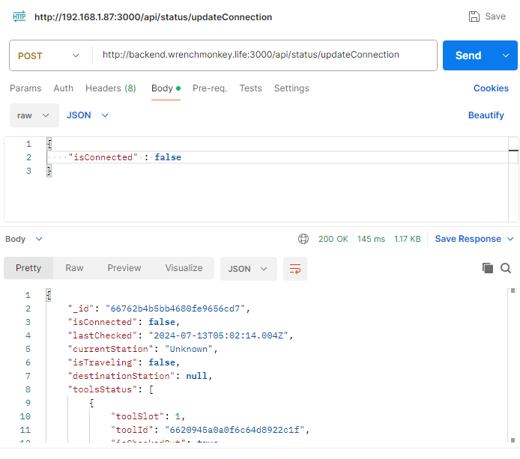
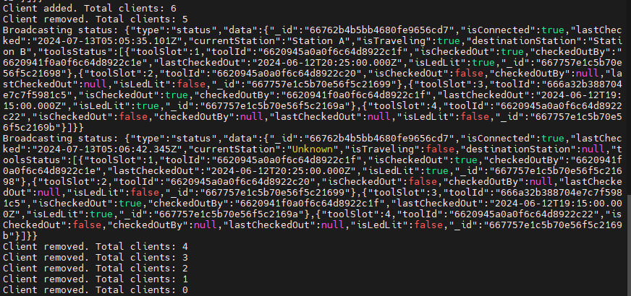
System Testing: Website
Sent commands to update connection status, validating the correct functioning and responsiveness of our API endpoints.
Tested real-time communication by ensuring the website receives responses from the robot through WebSocket, confirming instant updates and interactions.
Matthew Trump (CPE)
Notes:
Next, let's look at the system testing of the Wrench Monkey website. We conducted comprehensive tests to ensure the functionality and reliability of our system. Here, you can see two key aspects of our testing process. On the left, we have a screenshot of our backend server log, which shows the broadcasting status of the isConnected event, confirming that the server is actively monitoring and updating connection statuses. On the right, you see a screenshot from Postman, where we sent a command to update the connection status. This validates that our API endpoints are functioning correctly and the server is responding appropriately to incoming requests. These tests are crucial for verifying that our system maintains real-time communication between the end users and the ESP32 device.

Slide 33
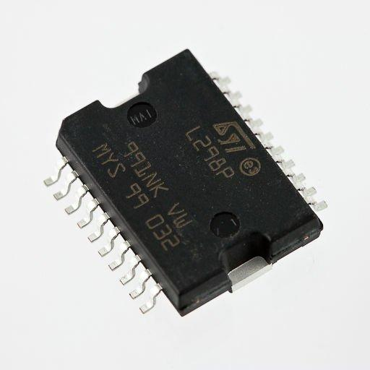
Difficulties Experienced: H-Bridge
William Wandelt (EE)
First iteration of our PCB had V_{SS} and V_{S} swapped
Second iteration didn’t have return path for load connected to ground
Initial tests led to chip nearly overheating
Notes:
So here are some of the difficulties we faced during the, starting with our motor controller H bridge. The biggest problem was in our first iteration PCB. The logic voltage supply and motor voltage supply, meaning 12 volts was fed to a pin that, per, the datasheet, should be given no more than 7. Needless to say, the chip was instantly destroyed. This unfortunately required a new PCB to be ordered as it could not be easily fixed. Additionally, the second iteration of our PCB had a problem where the motor would not turn on, and even destroyed one of our ESP32 modules after being connected for around a minute. This was due to the current sense pin of the h bridge actually being the return path for the load, as opposed to the ground connections of the chip. Fortunately, this was easily fixable by connecting the sense pins to ground.
Lastly, during our initial chassis testing, the chip reached well over 200 degrees fahrenheit, even with the thermal vias implemented. This lead to us adding a heatsink to the chip alongside a fan to dissipate heat and prevent the chip from overheating.

Slide 34
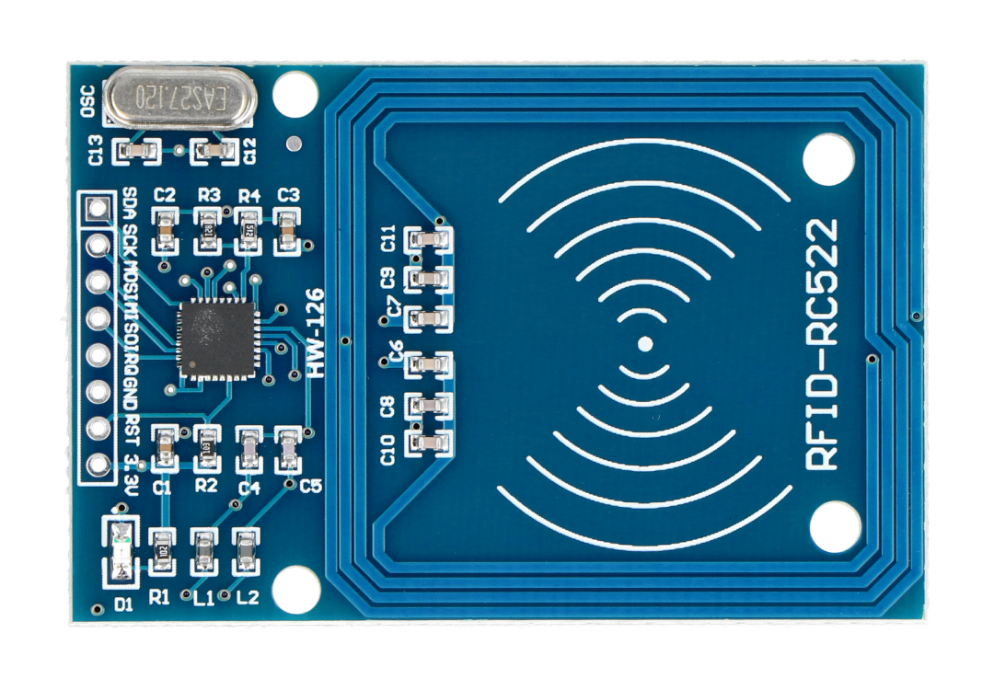
Difficulties Experienced: RFID
Matthew Crespo (EE)
Everything went wrong:
Uninitialized modules messed with SPI bus
Multiple custom functions had to be created for accessing the desired information
Issues with continuous reading of tags
Notes:
custom functions had to be made, like compare…
Issues with continuous read, buffer thing…
If all modules arent initialized in code, uninitialized modules cannibalize SPI bus, preventing the initialized modules from working properly…

Slide 35
Budget and Financing
Item | Quantity | Expected Cost | Unit Cost | Total
Toolbox | 1 | 15.00 | 15.00 | 15.00
Custom PCBs | 1 | 15.00 | 9.00 | 9.00
MCU (ESP32) | 1 | 3.00 | 2.68 | 2.68
Lead Acid 12v Battery | 1 | 20.00 | 19.00 | 19.00
LED Strip (12ft) | 1 | 15.00 | 13.99 | 13.99
RFID Sticker Roll | 1 | 17.00 | 16.59 | 16.59
RFID Module | 3 | 10.00 | 3.00 | 9.00
Ultrasonic Sensor | 2 | 5.00 | 2.00 | 4.00
IR Sensor Array | 1 | 12.00 | 11.99 | 11.99
Strain Gauge | 2 | 15.00 | 6.50 | 13.00
H-Bridge (L298P) | 3 | 30.00 | 10.87 | 32.61
Diodes (1N4007W) | 100 | 1.00 | 0.0063 | 0.63
Resistors | 50 | 3.00 | 0.05 | 2.50
Rachael Sak (EE)
Capacitors | 50 | 3.00 | 0.05 | 2.50
½x12x24in Birch Plywood | 1 | 10.00 | 9.88 | 9.88
Block Insert Bearing | 4 | 10.00 | 2.25 | 9.00
Uxcell Hex Coupler | 4 | 10.00 | 2.50 | 10.00
Linear Motion Rods | 2 | 10.00 | 4.25 | 8.00
Shaft Lock Collar | 10 | 9.00 | 0.89 | 8.89
Tires | 4 | 15.00 | 3.74 | 14.96
Hex Wheel Adapter | 2 | 6.00 | 2.98 | 5.96
DC Geared-Down Motor | 2 | 70.00 | 33.99 | 67.98
3D Printed Items | 6 | 5.00 | 0.66 | ~4.00
Estimated Cost | $309
Total Cost | $ 291.16
Notes:
For our budget and financing, we kept track of all the expenses for the Wrench Monkey project. The chart on this slide shows the individual items, quantity, unit cost, and total cost for each item we bought. Fortunately, some parts came in packages with more than one of the needed amount, which helped lower the overall cost per part. The chart is up to date with everything we've bought thus far leaving the grand total of our expenses to be 291 dollars, which is UNDER our original estimated budget by about 84$.

Slide 36
Workload Distribution
Rachael Sak (EE)
Task Description | Primary Team Member | Secondary Team Member
PCB Design | William Wandelt | Rachael S, Matthew C
Hardware Assembly | Rachael Sak | William Wandelt
Website Integration | Matthew Trump | N/A
Hardware Integration | Matthew Crespo | Rachael Sak
Hardware Debugging | William Wandelt | Rachael S, Matthew C
Software Integration | Matthew Trump | Matthew Crespo
System Testing | Matthew T, Matthew C | Rachael S, William W

Slide 37
Conclusion
Rachael Sak (EE)
Thoroughly read through documentation prior to starting
Start prototyping early on
Slowly integrate components to more easily find errors
Communicate and work as a group
Notes:
Many problems could have been solved earlier with more involved prototyping…

